Slide 1
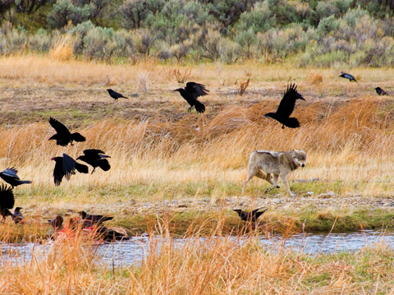
PORTFOLIO PROJECT
BIODIVERSITY IN US NATIONAL PARKS

Slide 2
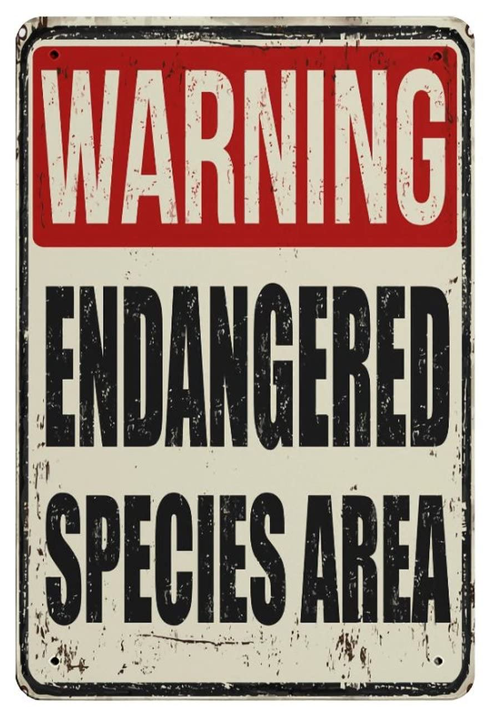
INTRODUCTION
This project is focused on interpreting data from the National Parks Service about endangered species.
Main Tasks
Analyze several species of animals/plants
Check their conservation status (whether they are in danger of extinction or not)
Look how many weekly observations of them we have in 4 US National Parks

Slide 3
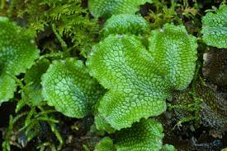
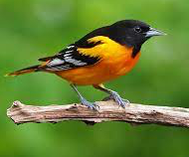
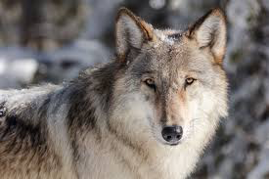
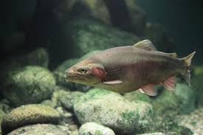
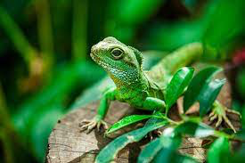
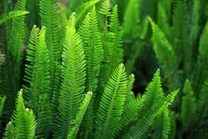
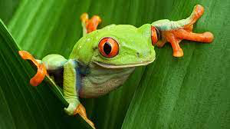
CATEGORIES OBSERVED
MAMMALS
NONVASCULAR PLANTS
FISHES
BIRDS
REPTILES
VASCULAR PLANTS
AMPHIBIANS

Slide 4
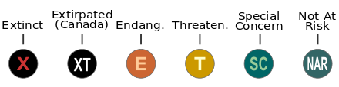
CONSERVATION STATUSES
Extinct
Threatened
Not At Risk (Safe)
Endangered
If a Species is improving its status, it is classified as “In Recovery”
Species of Concern

Slide 5
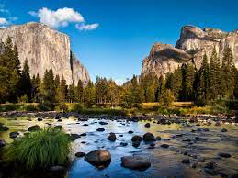
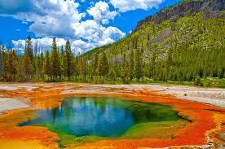
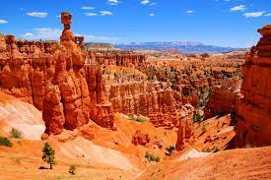
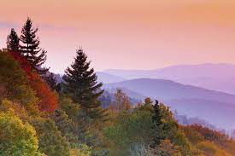
PARKS
YOSEMITE NATIONAL PARK
YELLOWSTONE NATIONAL PARK
GREAT SMOKY MOUNTAINS NATIONAL PARK
BRYCE NATIONAL PARK

Slide 6
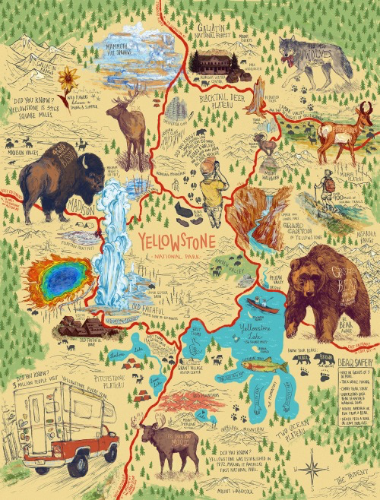
RESULTS

Slide 7
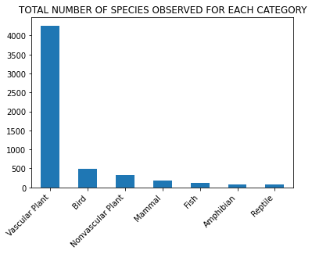
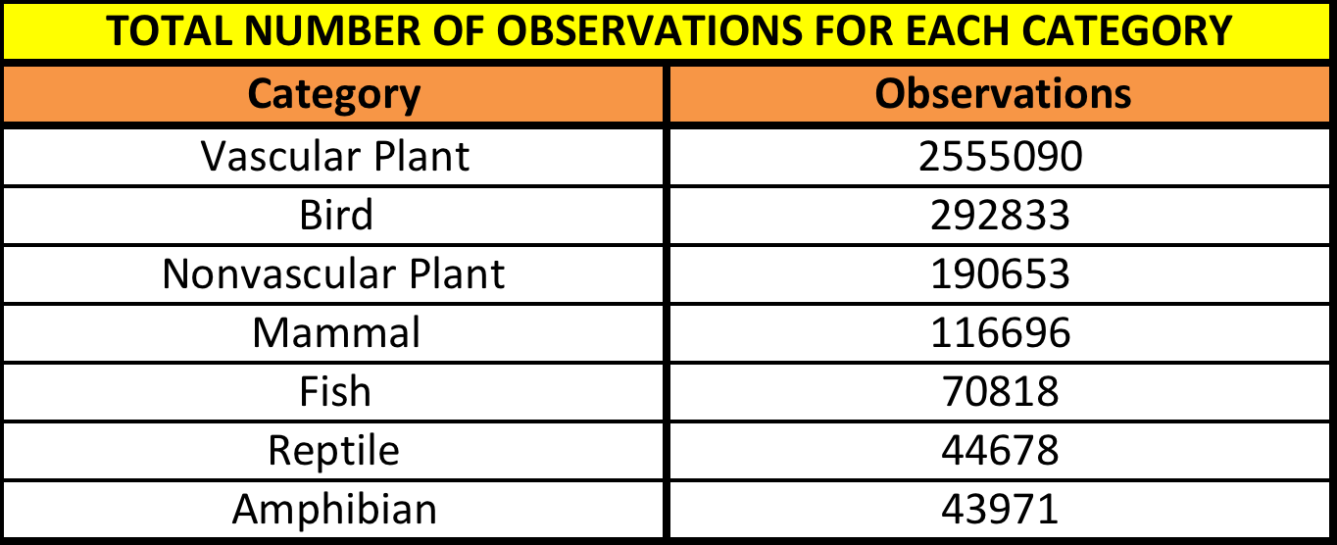
1 – Which category has the lowest observations? Which one the highest?
Vascular plant is the category with the highest number of both species observed and observations.
Reptiles and Amphibians are the ones with the lowest observations.

Slide 8
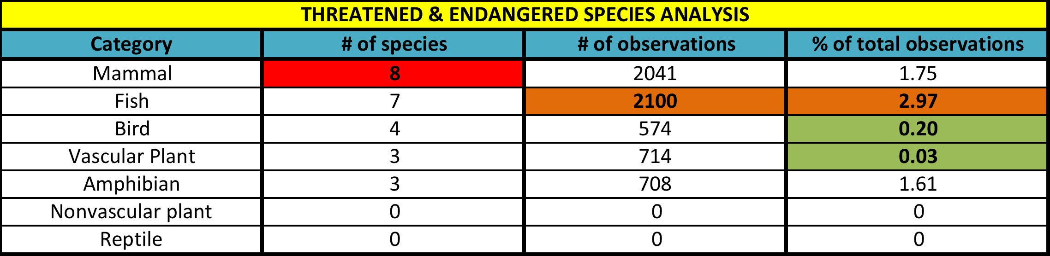
2 - Which category has the higher number of Endangered and Threatened species?
Mammal is the category with the highest number of species in danger
Fish is the category with highest number (and percentage) of observations of threatened and endangered species
Vascular plants and Birds, despite having the highest number of total observations, have a low percentage of observations of species in danger

Slide 9
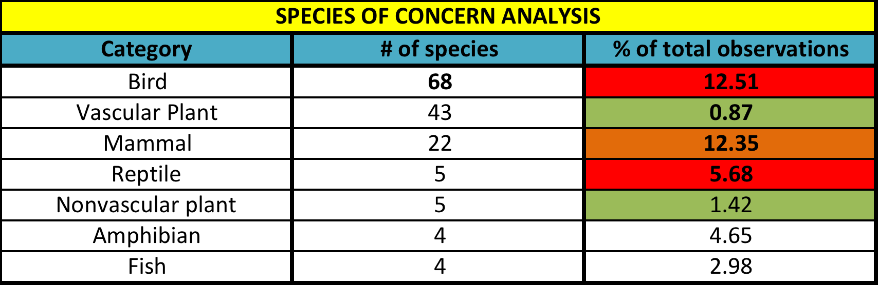
2 - Which category has the higher number of Endangered and Threatened species?
Birds and Reptiles have few to no species Endangered or Threatened observed, but the percentages of species of concern observed can be a bad signal for the future.
Fish is the category with highest number (and percentage) of observations of threatened and endangered species
Vascular plants and Birds, despite having the highest number of total observations, have a low percentage of observations of species in danger

Slide 10
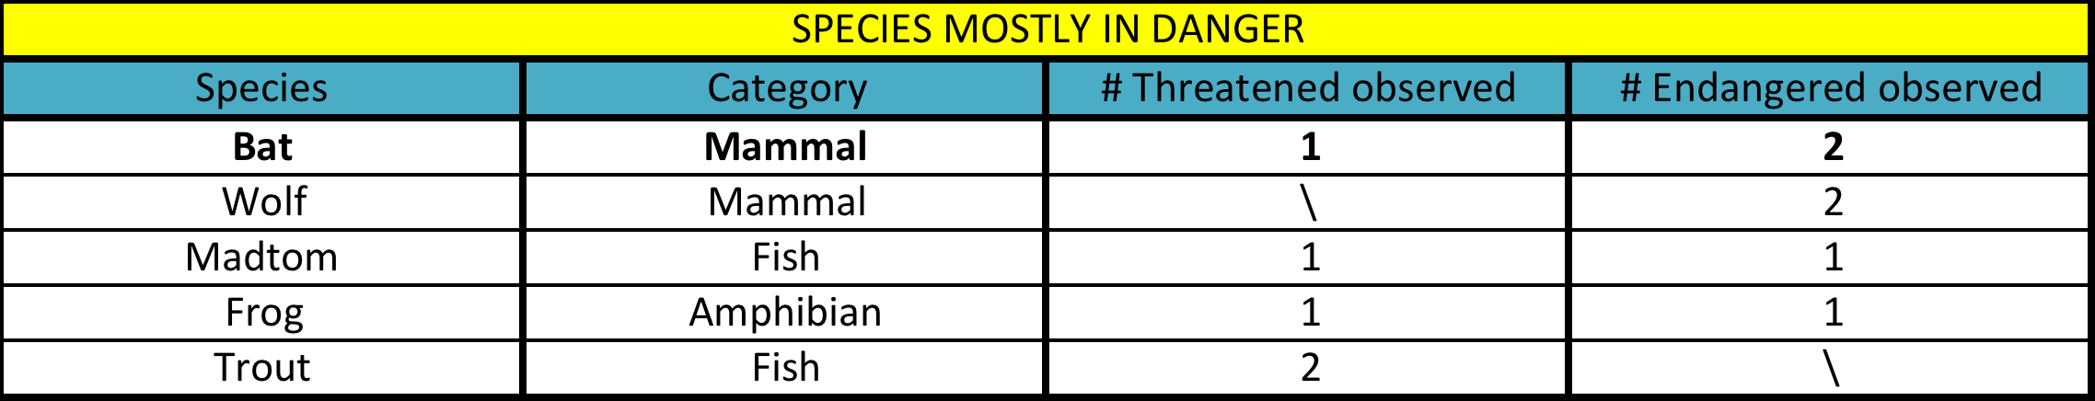
3 - Which kind of animals or plants are mostly in danger?
Bats are the ones with the highest number of Threatened or Endangered species observed
In general, based on the observations Mammal and Fish are the categories mostly in danger

Slide 11
4 – Are some categories more at risk than others (from a statistical point of view)?
To answer this question, we can check how many Safe (Not At Risk) and In danger species we have for each category, and then run a chi2 test between each category.
Category 1
Safe: x₁
In danger: y₁
Category 2
Safe: x₂
In danger: y₂
Chi2 test
Statistically
significant
Statistically
NOT significant
< 0,05
≥ 0,05
P-value

Slide 12
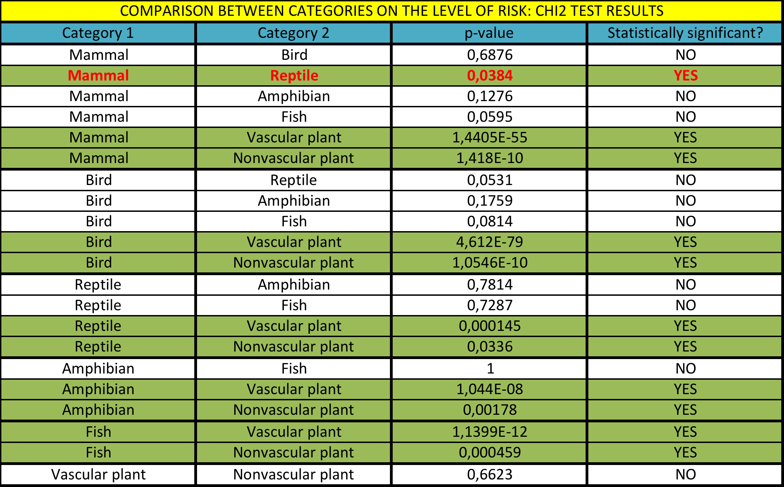
4 – Are some categories more at risk than others (from a statistical point of view)?

Slide 13
4 – Are some categories more at risk than others (from a statistical point of view)?
Plants have a statistically significant lower rate of extinction risk compared to animals
Among animals, a statistically significant difference in extinction risk exists only between Mammals and Reptiles (Mammals having higher risk)

Slide 14
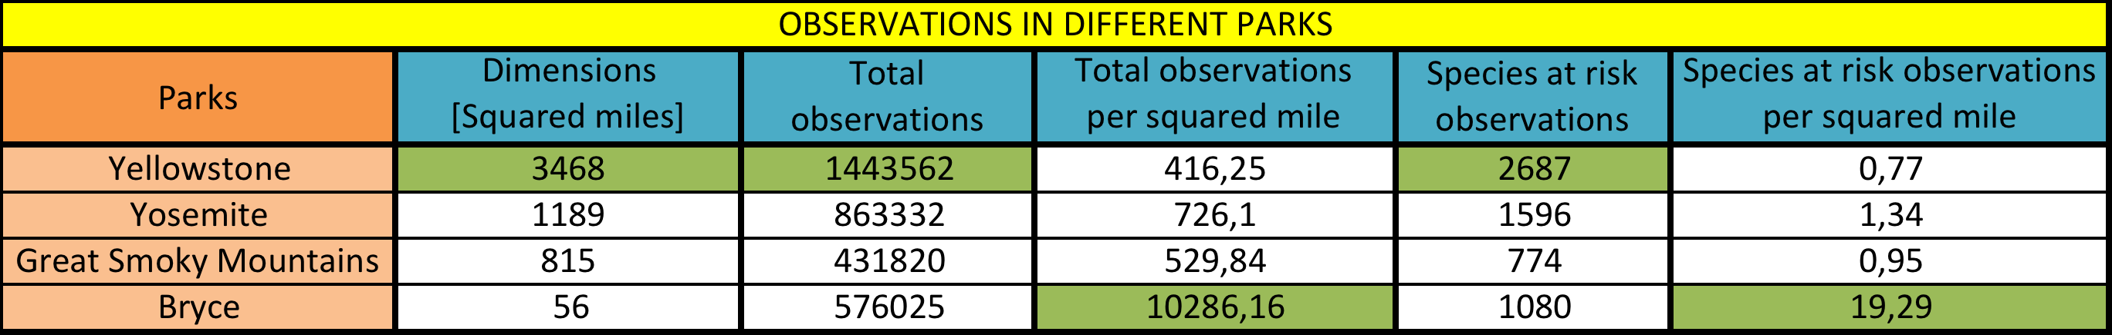
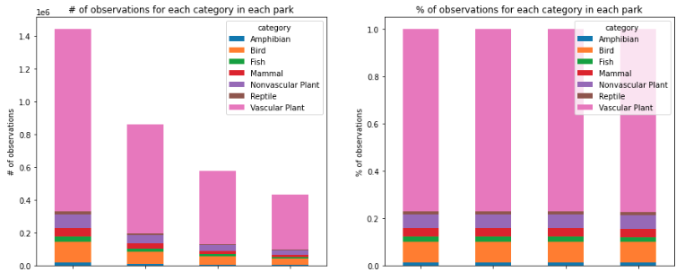
5 – Which park has the highest number of observations of Endangered and Threatened species?
Yellowstone
Yosemite
Bryce
Great Smoky
Mountains
Yellowstone
Yosemite
Bryce
Great Smoky
Mountains

Slide 15
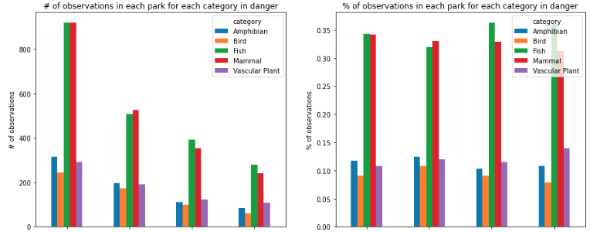
5 – Which park has the highest number of observations of Endangered and Threatened species?
Yellowstone
Yosemite
Bryce
Great Smoky
Mountains
Yellowstone
Yosemite
Bryce
Great Smoky
Mountains

Slide 16
5 – Which park has the highest number of observations of Endangered and Threatened species?
Yellowstone is the largest park, thus showing the highest number of observations, both in general and of species at risk.
The proportional distribution of category observed (in general) is exactly the same in all parks
The proportional distribution of species at risk observed shows some little differences among parks, with higher percentages of fishes in Bryce and Great Smoky Mountains parks compared to Yellowstone and Yosemite
Bryce National Park has the highest density of species observed per squared miles, both in general and for species at risk. It largely stands above the other parks in terms of densty of observations.

Slide 17
CONCLUSIONS
Plants (in particular Vascular Plants) are the most common in all parks considered, and luckily their risk of extinction is very low
Mammals are the species with the highest risk of extinction, since they are the category with the highest number of protected species. Among Mammals, Bats are the animals more in danger (with 3 species Endangered or Threatened), followed by Wolves (with 2 species Endangered or Threatened)
Birds have a high number of observation and low number of Endangered or Threatened species. Nevertheless, they have the highest number of Species of concern, thus their situation must be monitored carefully
Fishes have the highest percentage of species in danger seen, despite the number of total observations not that big. Madtoms are the fishes more in danger, with 2 species Endangered or Threatened

Slide 18
CONCLUSIONS
5) Amphibians and Reptiles have the lowest number of observations, and their conservation statuses are quite good (Reptiles have zero Endangered or Threatened species). Probably the low number of species observed influences the conservation status evaluations though.
6) Yellowstone National Park, being the biggest park considered (with 3468 squared miles), is the one with the highest number of observations, both in general and of species in danger.
7) Bryce National Park, despite being the smallest (with 56 squared miles), or maybe thanks to that, is the one with the highest density of species observed (both in general and in danger): almost 10300 observations per squared mile, among which more than 19 are of species in danger!

Slide 19
LIMITATIONS
The number of species considered is limited to the ones observed in one week.
The observations are limited to 4 National Parks.
The analysis we have done is just a photography of the distribution of species (with their conservation status) in a specific temporal frame. We do not have any follow up (has the situation improved for Mammals? Did Birds have a worsening in their conservation status as the number of Species of concer was suggesting?)

Slide 20
FUTURE WORKS
Here are some possible future developments to improve the analysis:
Consider observation in a timespan higher than one week
Extend the research to more National Parks
Analyze several sessions of observations in multiple years, in order for instance to check whether Species of concern get worse or species In recovery get better.

